Slide 1
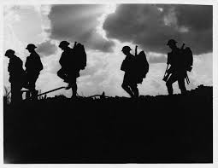
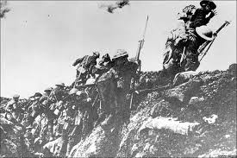
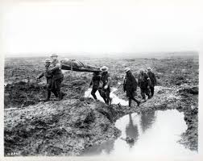
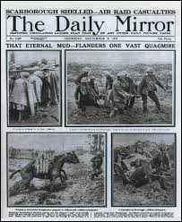
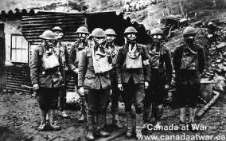
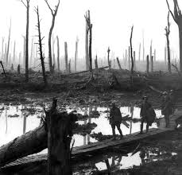
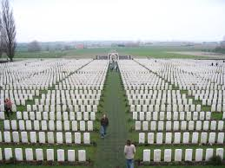
Battle of Passchendaele
JULY 11 1917- NOVEMBER 10 1917.

Slide 2
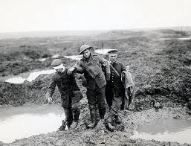
Who was involved?
During the battle of Passchendaele, many fought in this campaign. Countries on the allied forces involved were New Zealand, Australia, Canada, Britain and France. During this battle a total of 5000 NZ’s died fighting for victory. On the central power side was mainly Germany.

Slide 3
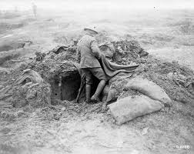
What was the battle of Passchendaele?
The battle of Passchendaele, also known as the third battle of Ypres, was fought to take pressure off the French in the south of Belgium. The ANZACS were the main allies involved in this battle, because they were the ones who fought against the Germans until the Canadians came along towards the end to help out with numbers that the allies were losing fast.

Slide 4
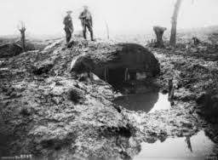
When was it?
The battle of Passchendaele was the 11th of July 1917 until 10th November 1917.

Slide 5
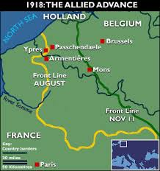
Where was it?
The Battle of Passchendaele was held in Passchendaele, near Ypres in Flanders, Belgium.

Slide 6
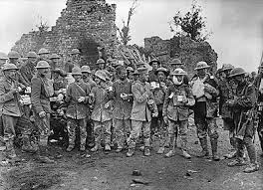
Why did the battle occur?
The battle occurred so that the British and their forces could help out the French to get the Germans off their backs. It also occurred so that the British could stop German supplies from reaching the enemy and to stop the U-boats from reaching German harbours.

Slide 7
bibliography
http://www.firstworldwar.com/battles/ypres3.htm
http://www.bbc.co.uk/history/worldwars/wwone/battle_passchendaele.shtml
http://www.nzhistory.net.nz/war/passchendaele-the-battle-for-belgium
http://passchendaelesociety.org/links/battles/
http://www.veterans.gc.ca/eng/remembrance/history/first-world-war/fact_sheets/passchendaele
http://www.mapsofworld.com/world-war-i/battle-of-passchendaele.html
http://www.historylearningsite.co.uk/battle_of_passchendaele.htm

